Slide 1
Bank Customer Occupation, Duration and Churn
A Look At Occupation

Slide 2
Overview - Hypothesis
We want to look at bank customers who churned: In a study using bank data we researched bank customers, their known occupations and their longevity with the establishment. Does occupation play a role in a person's duration with a bank?
Hypothesis: Given a customer's occupation, is there a difference in the duration of the relationship with the bank, for customers who churned?

Slide 3

What occupations do we see in our study?
Self-Employed
Salaried Employee
Company Owner
Retired
Students

Slide 4
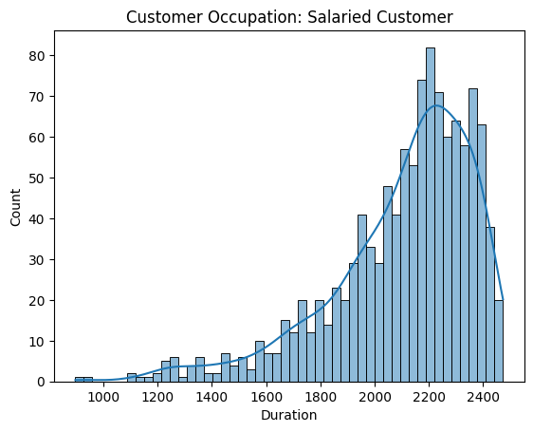
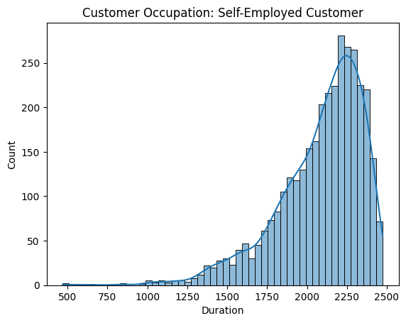
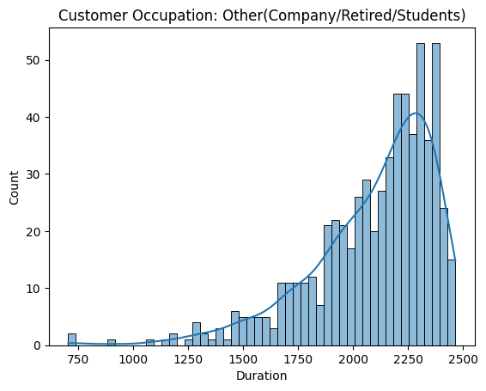
Occupation – Salaried vs Self-Employee vs Other
We will take a closer look at the difference for churned customers between salaried employees, self-employed and other and we will measure if there is an underlying difference in their duration with the bank.
* company, retired and student were grouped into the ‘other’ category

Slide 5
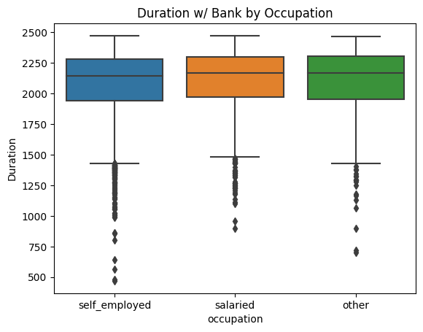
Does the data show any difference in duration based on occupation?

Slide 6
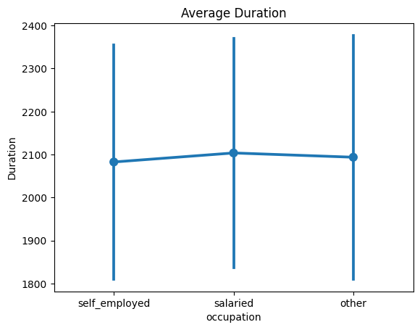
Results
There is a difference between salaried and self-employed customers who had churned
We can say with 95% confidence (p-value < 0.05) that the difference was not due to error– though the difference is not a huge one
The difference in means between these groups is between 3 and 39
No significant difference was observed between any other groups
e.g. other vs self-employed
e.g. other vs salaried

Slide 7
Conclusion
Observations
There was a small statistical difference between salaried and self-employed customer’s duration with the bank, before churning
There was no statistical difference between self-employed and other occupations
There was no statistical difference between salaried and other occupations
Recommendations
Further studies should be done to specifically test salaried vs self-employed customers and assess for any additional differences between groups, as this can offer added insights to help bank owners cater to customers differently, based on their occupations and perhaps reduce churn.
Moreover, perhaps a bias in this study was combining company, retired and students, into one group and it may be that these categories should be looked at separately, as behavior for a retiree may look much different than that of a business owner

